Slide 1
Computer Networks
Lecture 6: Application Layer
Prepared and modified by:
Assoc.Prof.Dr. Hossam Mahmoud Moftah
Associate Professor – Faculty of Computers and Artificial Intelligence– Beni-Suef University

Slide 2
Chapter 2: outline
2.1 principles of network applications
  app architectures
  app requirements
2.2 Web and HTTP
2.3 FTP
2.4 electronic mail
  SMTP, POP3, IMAP
2.5 DNS
2.6 P2P applications
2.7 socket programming with UDP and TCP
Adapted from J.F Kurose and K.W. Ross March 2012
Application Layer
2-<number>

Slide 3
Uploading form input
POST method:
web page often includes form input
input is uploaded to server in entity body
URL method:
uses GET method
input is uploaded in URL field of request line:
www.somesite.com/animalsearch?monkeys&banana
Adapted from J.F Kurose and K.W. Ross March 2012
Application Layer
2-<number>

Slide 4
HTML Forms and Server-side Data
some web pages allow us to submit our own new data
most server-side web programs accept parameters that guide their execution

Slide 5
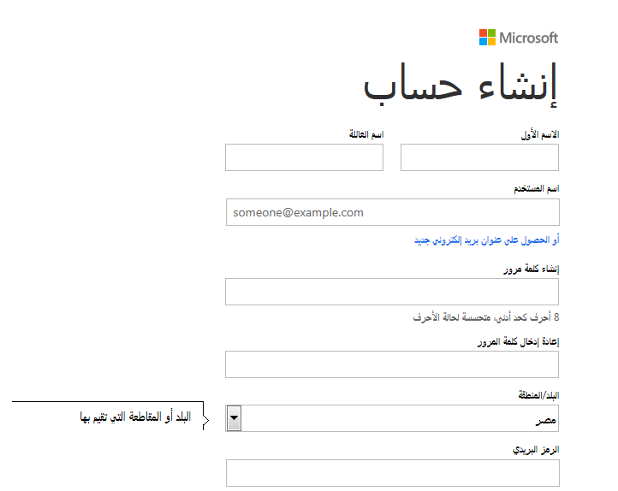
Form Example: Creating email account

Slide 6
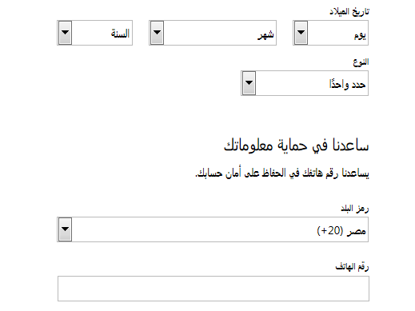

Form Example: Creating email account

Slide 7
Method types
HTTP/1.0:
GET
POST
HEAD
HTTP/1.1:
GET, POST, HEAD
PUT
  uploads file in entity body to path specified in URL field
DELETE
  deletes file specified in the URL field
HEAD
  Used when the client is requesting some information about a resource but not requesting the resource itself.
Adapted from J.F Kurose and K.W. Ross March 2012
Application Layer
2-<number>

Slide 8
Method types
HTTP/1.1:
CONNECT
  Used when the client wants to establish a transparent connection to a remote host, usually to facilitate SSL-encrypted communication (HTTPS) through an HTTP proxy.
Adapted from J.F Kurose and K.W. Ross March 2012
Application Layer
2-<number>

Slide 9
HTTP response message
ETags are a mechanism that web servers and browsers use to validate cached components.
status line
(protocol
status code
status phrase)
HTTP/1.1 200 OK\r\n
Date: Sun, 26 Sep 2010 20:09:20 GMT\r\n
Server: Apache/2.0.52 (CentOS)\r\n
Last-Modified: Tue, 30 Oct 2007 17:00:02 GMT\r\n
ETag: "17dc6-a5c-bf716880"\r\n
Accept-Ranges: bytes\r\n
Content-Length: 2652\r\n
Keep-Alive: timeout=10, max=100\r\n
Connection: Keep-Alive\r\n
Content-Type: text/html; charset=ISO-8859-1\r\n
\r\n
data data data data data ...
header
lines
Maximum 100 requests in 10 seconds
data, e.g.,
requested
HTML file
Adapted from J.F Kurose and K.W. Ross March 2012
Application Layer
2-<number>

Slide 10
HTTP response status codes
status code appears in 1st line in server-to-client response message.
some sample codes:
200 OK
  request succeeded, requested object later in this msg
301 Moved Permanently
  requested object moved, new location specified later in this msg (Location:)
400 Bad Request
  request msg not understood by server
404 Not Found
  requested document not found on this server
505 HTTP Version Not Supported
Application Layer
2-<number>

Slide 11
User-server state: cookies
example:
Ibrahim always access Internet from PC
visits specific e-commerce site for first time
when initial HTTP requests arrives at site, site creates:
  unique ID
  entry in backend database for ID
many Web sites use cookies
four components:
  1) cookie header line of HTTP response message
  2) cookie header line in next HTTP request message
  3) cookie file kept on user’s host, managed by user’s browser
  4) back-end database at Web site
Application Layer
2-<number>

Slide 12

Cookies: keeping “state” (cont.)
client
server
ebay 8734
usual http request msg
Amazon server
creates ID
1678 for user
cookie file
usual http response
set-cookie: 1678
backend
database
create
entry
ebay 8734
amazon 1678
usual http request msg
cookie: 1678
cookie-
specific
action
access
usual http response msg
one week later:
access
ebay 8734
amazon 1678
usual http request msg
cookie: 1678
cookie-
specific
action
usual http response msg
Application Layer
2-<number>

Slide 13
Cookies (continued)
what cookies can be used for:
authorization
shopping carts
user session state (Web e-mail)
Application Layer
2-<number>

Slide 14
Using Cookies to Store Session Data using ASP.Net(C#)
Creating a cookie:
HttpCookie objCookie = new HttpCookie("myCookie");
DateTime now = DateTime.Now;
objCookie.Values.Add("Time", now.ToString());
objCookie.Expires = now.AddHours(1);
Response.Cookies.Add(objCookie);
To create a persistent cookie, specify the expiration time

Slide 15
Retrieving Information from a Cookie using ASP.Net(C#)
Read the cookie
Retrieve values from the cookie
HttpCookie objCookie = Request.Cookies["myCookie"];
lblTime.Text = objCookie.Values["Time"];

Slide 16
Chapter 2: outline
2.1 principles of network applications
  app architectures
  app requirements
2.2 Web and HTTP
2.3 FTP
2.4 electronic mail
  SMTP, POP3, IMAP
2.5 DNS
2.6 P2P applications
2.7 socket programming with UDP and TCP
Application Layer
2-<number>

Slide 17

Web caches (proxy server)
goal: satisfy client request without involving origin server
user sets browser: Web accesses via cache
browser sends all HTTP requests to cache
  object in cache: cache returns object
  else cache requests object from origin server, then returns object to client
proxy
server
HTTP request
HTTP request
client
origin
server
HTTP response
HTTP response
HTTP request
HTTP response
client
origin
server
Application Layer
2-<number>

Slide 18
What is a Web Proxy Server?
It is a specialized HTTP Server.
Functions as a firewall.
  Protects client computers from Hackers by limiting outside access to clients.
Allows all clients connected to Web Proxy Server to access Internet from behind “firewall.”

Slide 19
How Does A Web Proxy Server Work?
Web Proxy Server listens for any request from clients.
All requests are forwarded to remote internet servers outside firewall.
Also listens for responses or request from outside the firewall (external servers) and sends to them to internal client computers.
All that is needed is the proxy server’s IP address.

Slide 20
How Does A Web Proxy Server Work?
Usually, all clients with a subnet use the same proxy server.
This makes it possible for the proxy server to cache documents that are requested by one or more clients (repeatedly).
For clients using a web proxy server, it is as if they are getting responses directly from a remote server.
Caching documents means keeping a copy of internet documents so the server doesn’t need to request them over again.

Slide 21
More about Web caching
why Web caching?
reduce response time for client request
reduce traffic on an institution’s access link
enables “poor” content providers to effectively deliver content (so too does P2P file sharing)
Application Layer
2-<number>

Slide 22
Difference Between a Firewall and a Proxy Server
A firewall and a proxy server are both components of network security.
To some extent, they are similar in that they limit or block connections to and from your network, but they accomplish this in different ways.
Firewalls can block ports and programs that try to gain unauthorized access to your computer, while proxy servers basically hide your internal network from the Internet.
Application Layer
2-<number>

Slide 23
Difference Between a Firewall and a Proxy Server
Proxy servers works as a firewall in the sense that it blocks your network from being exposed to the Internet by redirecting Web requests when necessary.
A firewall can prevent programs from running on your computer. A proxy server cannot do this.
Application Layer
2-<number>

Slide 24
Chapter 2: outline
2.1 principles of network applications
  app architectures
  app requirements
2.2 Web and HTTP
2.3 FTP
2.4 electronic mail
  SMTP, POP3, IMAP
2.5 DNS
2.6 P2P applications
2.7 socket programming with UDP and TCP
Application Layer
2-<number>

Slide 25
FTP: separate control, data connections
FTP client contacts FTP server at port 21, using TCP
client authorized over control connection
client browses remote directory, sends commands over control connection
when server receives file transfer command, server opens 2nd TCP data connection (for file) to client
after transferring one file, server closes data connection
TCP control connection,
server port 21
FTP
client
TCP data connection,
server port 20
FTP
server
server opens another TCP data connection to transfer another file
FTP server maintains “state”: current directory, earlier authentication
Application Layer
2-<number>

Slide 26
FTP commands, responses
sample commands:
sent as ASCII text over control channel
  USER username
  PASS password
  LIST return list of file in current directory
  RETR filename retrieves (gets) file
  STOR filename stores (puts) file onto remote host
sample return codes
status code and phrase (as in HTTP)
  331 Username OK, password required
  125 data connection already open; transfer starting
  425 Can’t open data connection
  452 Error writing file
Application Layer
2-<number>

Slide 27


Python response
Content
Headers
Application Layer
2-<number>

Slide 28



Python Status Codes
  Status codes
  you can simplify the last example by rewriting the if statement
Application Layer
2-<number>

Slide 29
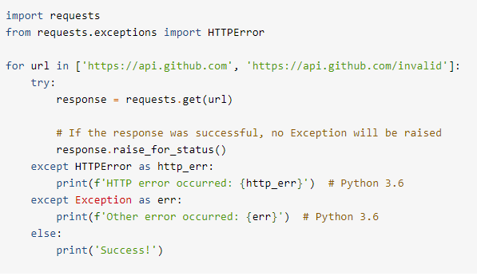
Python Status Codes
  check the response’s status code in an if statement
Application Layer
2-<number>

Slide 30
The end
Application Layer
2-<number>

